Slide 1
Kotlin Multiplatform Mobile
21st August 2021
Oliver Muthomi
@muth0mi

Slide 2
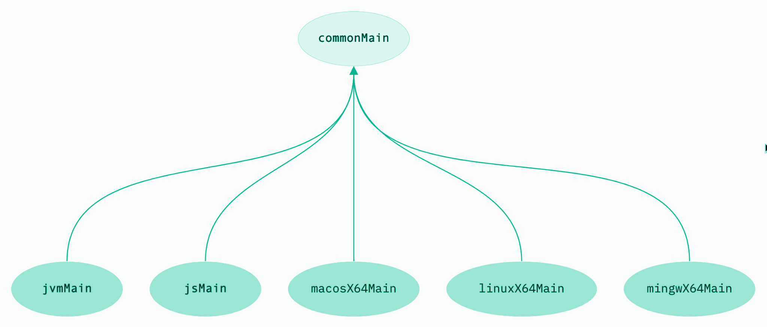
About Kotlin Multi Platform - KMP
Shared business logic for your applications, in pure Kotlin
Notes:
KMP allows one to create common shared library modules that can be depended on from various targets and languages.
Just like GraalVM compiles java/kotlin to OS dependent native binary application, KMP compiles into a target dependent binary lib, one can import into an existing project.

Slide 3
Wait, WHY KMP?
Notes:
So now, why should we choose KMP over existing solutions, Flutter, Xamarin, React?

Slide 4
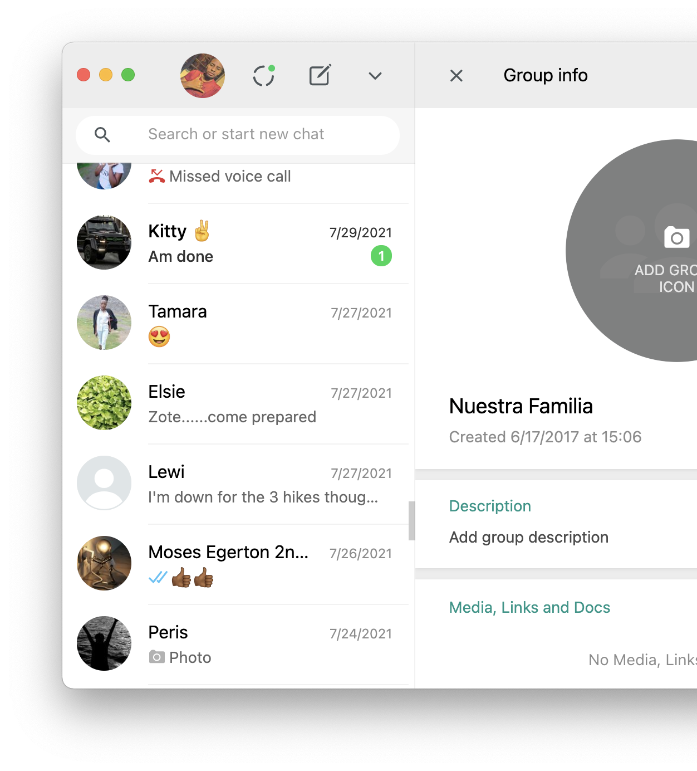
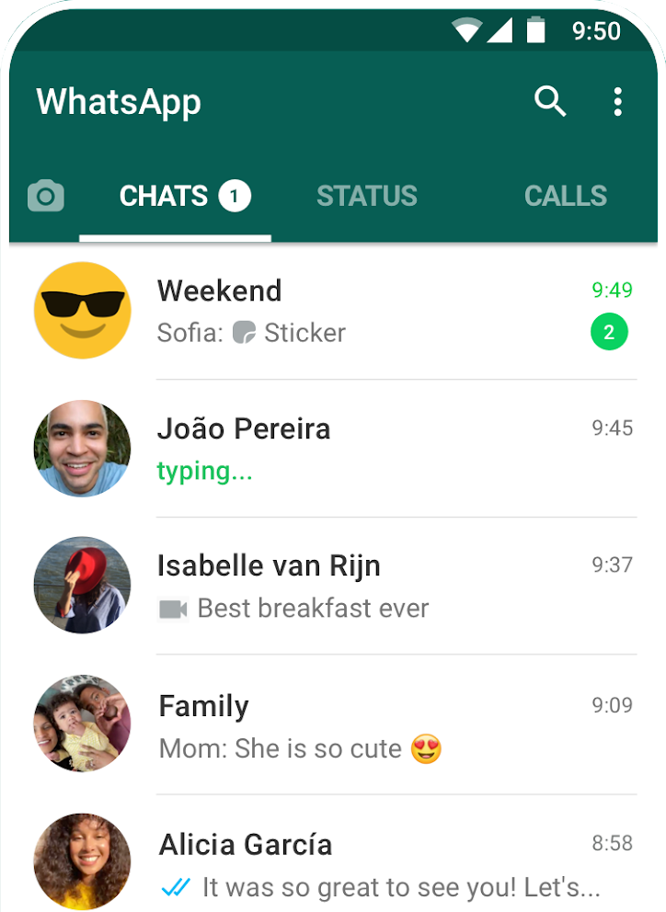
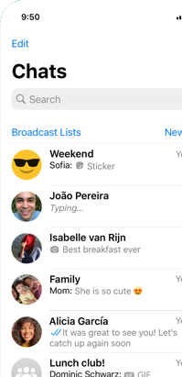
Avoid logic REduplication While Keeping UI Native.
Notes:
Quality apps feel like they were specifically for the OS they run on. They compliment the OS. For the longest time Android apps felt inferior to those of iOS due to the variations offered by touchwiz, HTC sense, ColorOS, etc. They did not fit until Material design came and revolutionized everything.
Material UI doesn’t fit well on iOS (Human Design), Web (Bootstrap, Tailwind), Windows (Fluent), Unconventional Systems - USSD, API?
Leverage on platform specific frameworks and libraries. Animations, Google Maps vs Apple Maps.
Adopt new platform specific libraries immediately without compromising other targets. Material You, 3D features in Apple Map, Bootstrap 5, Fluent, etc (Adopt windows 11 new looks)

Slide 5
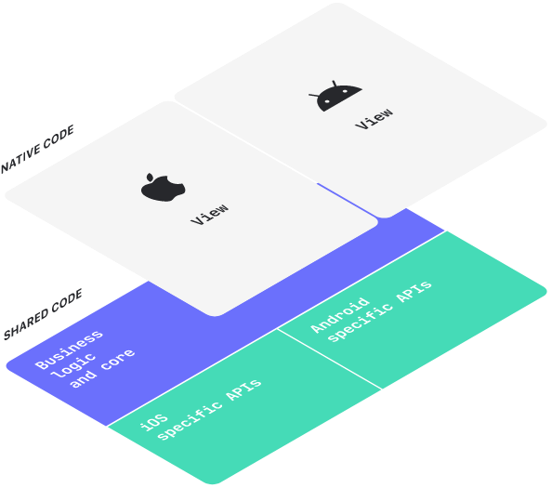
KMM
Multiplatform Mobile
Single codebase for the business logic of both iOS and Android apps
Notes:
- KMM is an abstraction of KMP specifically for Mobile development
- This involves having a single codebase for the business logic of both iOS and Android apps
Android specific APIs:
CameraX, Ml-Kit, Biometric, Room, Play-services, Retrofit, etc
iOS specific APIs:
AVFoundation, Core ML, Local Authentication, Accounts, Cloudkit, etc
Motivation:
Avoid doing the job twice.
Love DRY
Have less experience with iOS but wanna get started
Don’t like existing solutions for some reson

Slide 6

PRO’s
CON’s
Native UI & Libraries
Adopt new technologies without overhead
Learning curve for iOS devs
While, nothing changes for Android, iOS devs gotta learn kotlin
Small Binaries Size
Regular library module for Android
Regular framework library for iOS
Extra-Platform dependent code
Unlike Flutter, Xamarin, React, you gotta write UI multiple times
Multiple Targets
iOS, Windows, Linux, Mobile, JVM, JS, Custom, ...
Zero Performance Impact
No Skia, No compiler abstractions
Pre-Release
But you love, canary releases, nah?
Improved Code Quality
Modularization, consistency b2n apps, reduced testing effort, etc

Slide 7





So, Production Ready?
Nah, but ...
https://kotlinlang.org/lp/mobile/case-studies/
Notes:
- AirBnB: Ongoing talks

Slide 8

Tooling
AppCode (or AS + xcode)
Allows you to work on both iOS and Android projects in same IDE.
KMM SDK (JB plugin)
Templating multiplatform projects. Port features like expect, actual.
Some gradle Understanding
How to call platform APIs, add different dependencies, ...
Notes:
AppCode is only available for Mac. You can still use Android studio on Windows/Linux but won’t be able to compile for Apple targets
AppCode: We’ve created a special Gradle DSL for describing iOS projects that does not require having .xcodeproj or .xcworkspace.

Slide 9
Okay, I’m sold, Hello World?
Notes:
So now, why should we choose KMP over existing solutions, Flutter, Xamarin, React?

Slide 10

Cool, but … it’s no greenfield.!!
Notes:
Quality apps feel like they were specifically for the OS they run on. They compliment the OS. For the longest time Android apps felt inferior to those of iOS due to the variations offered by touchwiz, HTC sense, ColorOS, etc. They did not fit until Material design came and revolutionized everything.
Material UI doesn’t fit well on iOS (Human Design), Web (Bootstrap, Tailwind), Windows (Fluent), Unconventional Systems - USSD, API?
Leverage on platform specific frameworks and libraries. Animations, Google Maps vs Apple Maps.
Adopt new platform specific libraries immediately without compromising other targets. Material You, 3D features in Apple Map, Bootstrap 5, Fluent, etc (Adopt windows 11 new looks)

Slide 11
Ownership
Have Android dev team develop shared module for your applications, in pure Kotlin. Have iOS adopt it.
Have iOS dev team learn kotlin and develop shared module together with the Android Team.
Consolidate a independent team to work on shared module. Work on iOS and Android modules has reduced significantly.
Notes:
KMP allows one to create common shared library modules that can be depended on from various targets and languages.
Just like GraalVM compiles java/kotlin to OS dependent native binary application, KMP compiles into a target dependent binary lib, one can import into an existing project.

Slide 12
2. Make your code cross-platform (Android)﻿
Create a KMM Shared Module in your Android project.
Add a gradle dependency to you App Module.
Refactor business logic into shared module. Share as much as possible
Plug into any platform APIs, (room, broadcast receivers, libraries, ...) using expect -> actual functionality.
Notes:
KMP allows one to create common shared library modules that can be depended on from various targets and languages.
Just like GraalVM compiles java/kotlin to OS dependent native binary application, KMP compiles into a target dependent binary lib, one can import into an existing project.

Slide 13
3. Make your code cross-platform (iOS)﻿
In project settings > Build Phases add a New Run Script Phase.
cd "$SRCROOT/.." ./gradlew:shared:embedAndSignAppleFrameworkForXcode
In Build Settings > Framework Search Path add:
$(SRCROOT)/../shared/build/xcode-frameworks/$(CONFIGURATION)/$(SDK_NAME)
In Build Settings > Other Linker flags add:
(inherited) -framework shared
Notes:
KMP allows one to create common shared library modules that can be depended on from various targets and languages.
Just like GraalVM compiles java/kotlin to OS dependent native binary application, KMP compiles into a target dependent binary lib, one can import into an existing project.

Slide 14
TELL ME.., WHAT GON BE
HARD?
Notes:
So now, why should we choose KMP over existing solutions, Flutter, Xamarin, React?

Slide 15

CONCURENCY $ REACTIVITY… Suspend, FLOWs,
Notes:
Flow wrappers

Slide 16

MVVM … Shared Viewmodels
Notes:
MVI works well enough.
ICEROCK MOKO

Slide 17

3rd Party Support … SHARED Libraries
Notes:
KTOR
SQDelight
Fuel
Lottie

Slide 18
Not Bought? YET? Shoot YaH QUIZ?
github.com/KotlinKenya/Spood
Notes:
So now, why should we choose KMP over existing solutions, Flutter, Xamarin, React?

